Slide 1

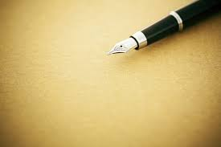
Polishing Style
2024

Slide 2




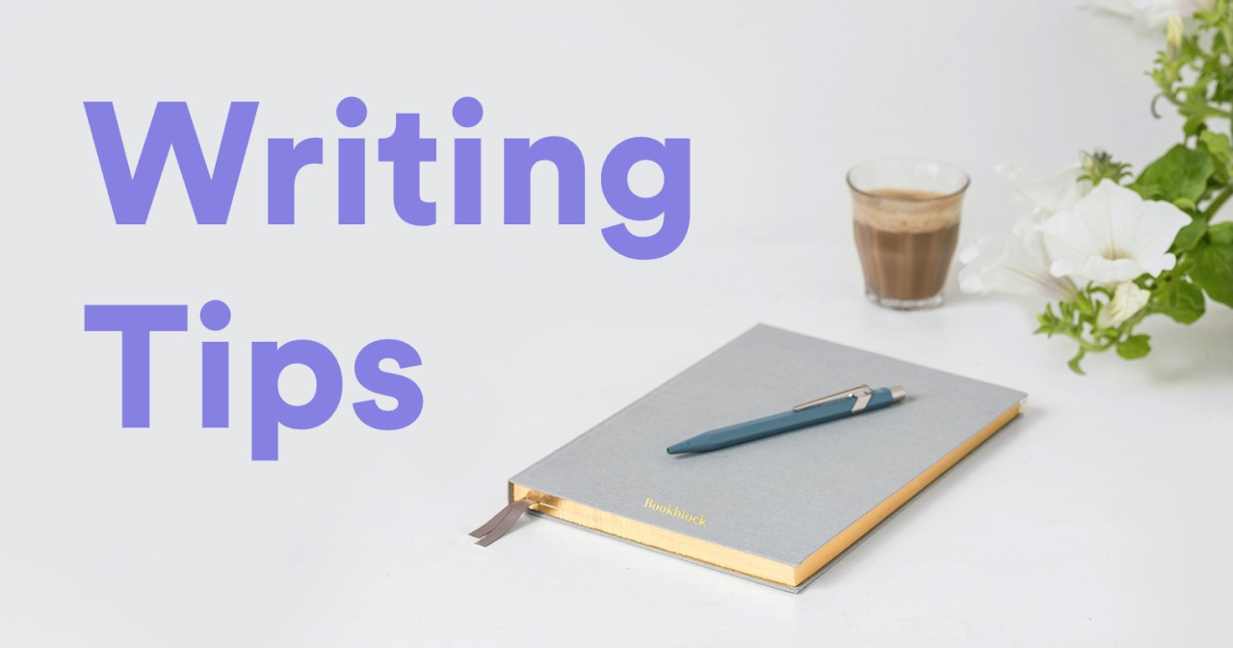
www.tuf.edu.pk
unioffaisalabad

Slide 3

www.tuf.edu.pk
unioffaisalabad
Writing is an art form that requires constant refinement. Whether you're an aspiring novelist, a professional content creator, a student working on assignments, a technical or business writer or someone who simply wants to improve their writing skills, improving your writing skills is crucial for producing polished and impactful work.

Slide 4
www.tuf.edu.pk
unioffaisalabad
In technical and business writing, polishing style involves refining the content to ensure that the writing is clear, precise, and professional while effectively communicating complex ideas to the intended audience. This stage of refinement is particularly important in these contexts because the primary goal is to convey information accurately and efficiently.

Slide 5
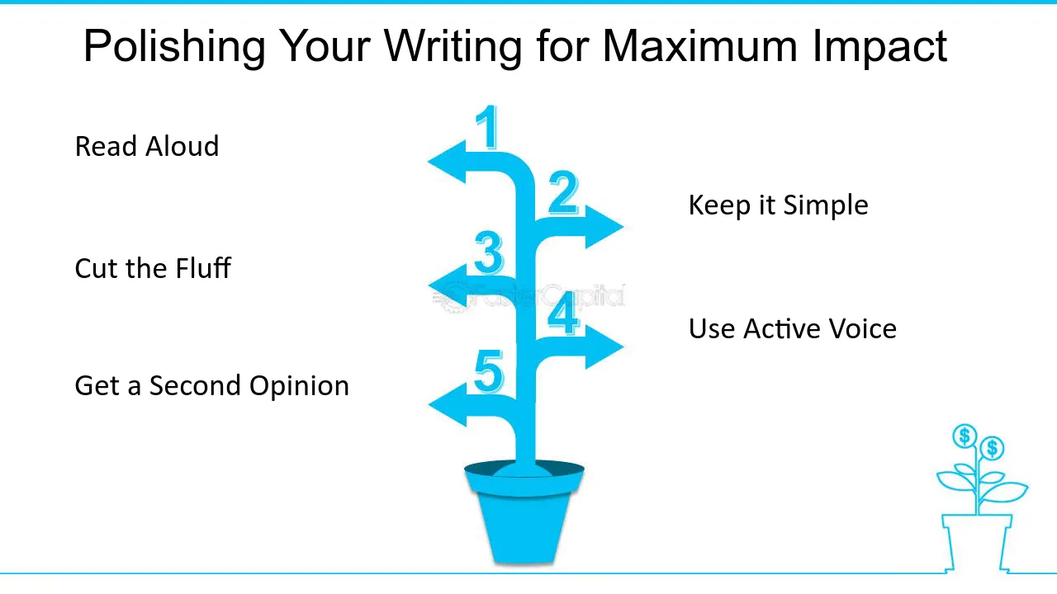
www.tuf.edu.pk
unioffaisalabad

Slide 6
www.tuf.edu.pk
unioffaisalabad
Here are some key aspects of polishing style in writing:
Clarity and Precision: Ensuring that the ideas are clear and the language is precise. This might involve eliminating vague terms or phrases.
Conciseness: Removing unnecessary words or sentences that do not add value. Polished writing is usually more direct and to the point.
Flow and Coherence: Ensuring smooth transitions between sentences and paragraphs so that the text reads naturally and logically.

Slide 7
www.tuf.edu.pk
unioffaisalabad
Variety in Sentence Structure: Polishing often includes varying sentence lengths and structures to avoid monotony and maintain the reader’s interest.
Grammar and Syntax: Correcting grammatical errors, punctuation mistakes, and awkward phrasing to make the writing sound more professional and polished.
Tone Consistency: Making sure the tone is appropriate for the audience and consistent throughout the piece.
Word Choice: Choosing words that fit the tone, style, and purpose of the piece while avoiding overuse of certain words or clichés.

Slide 8
www.tuf.edu.pk
unioffaisalabad
CONCLUSION
In essence, polishing style in writing is about fine-tuning the content so it communicates the intended message with clarity, efficiency, and elegance.

Slide 9

Improving Paragraphs (Length, order, clarity)

Slide 10
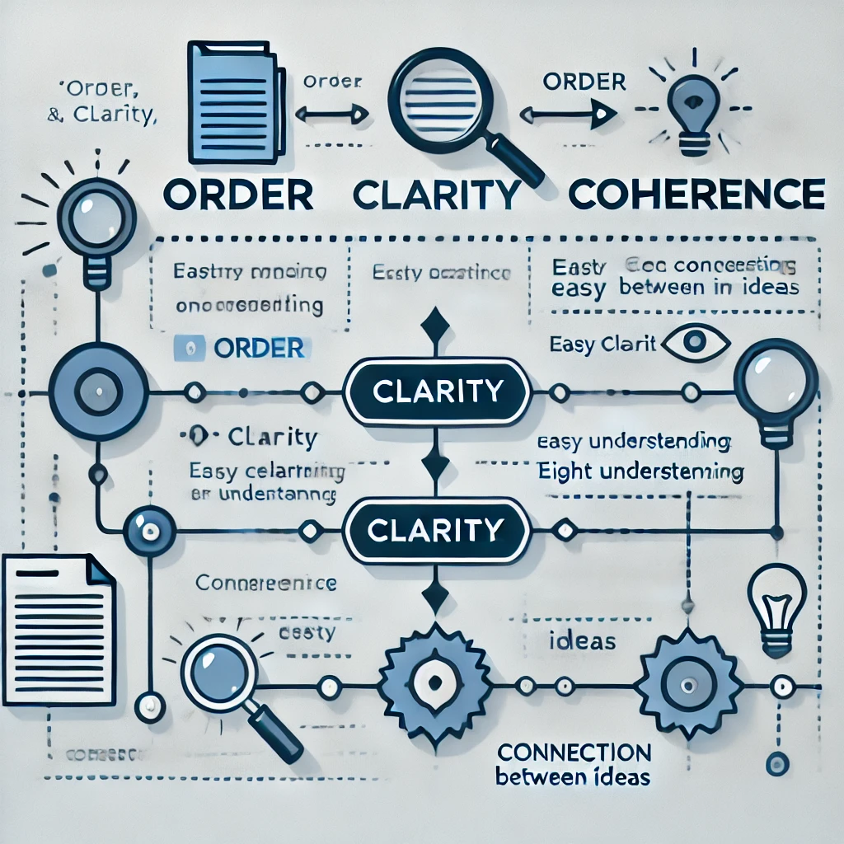

Slide 11
www.tuf.edu.pk
unioffaisalabad
Order, clarity, and coherence are fundamental to creating effective and well-structured paragraphs. These elements ensure that the reader can easily follow the writer’s ideas and understand the message being conveyed. Here's why they are essential:
1. Order
Logical Progression: Order helps the reader follow the thought process of the writer and understand how the points connect. Whether it’s chronological, cause-and-effect, or building from general to specific, the correct order prevents confusion and keeps the reader engaged.
Flow of Information: A well-ordered paragraph smoothly guides the reader from one point to the next. Without a logical order, the reader may struggle to grasp the significance of each point or its relationship to the overall argument or narrative.
Emphasizing Key Ideas: Order helps prioritize information. For example, placing important points first or last can give them more weight, while supporting details should be placed in the middle.

Slide 12
www.tuf.edu.pk
unioffaisalabad
2. Clarity
Easily Understood Ideas: Clarity ensures that the meaning of each sentence is immediately apparent to the reader. When ideas are expressed clearly, the reader doesn’t need to re-read sentences or guess what the writer is trying to say. Clear language ensures effective communication and minimizes misunderstanding.
Directness: Clarity often involves being direct and avoiding unnecessary complexity. Simple, straightforward language helps convey ideas in a better way.
Reduced Ambiguity: Ambiguity can confuse the reader and dilute the intended message. Clarity eliminates vague terms and unclear pronoun references, ensuring that the reader always knows what is being discussed.

Slide 13
www.tuf.edu.pk
unioffaisalabad
3. Coherence
Connection Between Ideas: Coherence ties together the individual ideas within a paragraph to form a unified whole. Each sentence should connect logically to the next, either by continuing a thought or introducing a new point that builds on the previous one.
Smooth Transitions: Coherence is often achieved through the use of transitional words and phrases (e.g., “therefore,” “in addition,” “however”).
Maintaining Focus: Coherence also ensures that the paragraph stays focused on one topic or idea. Each sentence should contribute to developing that main point, rather than veering off into unrelated tangents. This gives the paragraph a sense of unity and purpose.

Slide 14

www.tuf.edu.pk
unioffaisalabad
Why These Elements Matter:
Reader Engagement: When a paragraph is well-ordered, clear, and coherent, the reader can easily follow and remain engaged with the content. This keeps the reader's attention and interest.
Comprehension: Lack of order, clarity, or coherence can confuse the reader, forcing them to re-read sections or, worse, lose interest altogether. When all three are present, the paragraph becomes easier to read, understand, and remember.
Credibility: Writing that demonstrates clear thinking and logical progression enhances the writer’s credibility. Readers are more likely to trust and value writing that is organized and well thought out.

Slide 15
Conclusion
In summary, order, clarity, and coherence are essential to effective paragraph writing because they ensure that ideas are presented logically, are easy to understand, and are meaningfully connected. Together, they make the writing engaging, professional, and persuasive.

